Slide 1
App to App Communication
A Developer's Guide to Windows 10 Andy & Jerry

Slide 2
Agenda
App to App in Windows 8.1
URI and Protocol Activation
Share Contract
App to App in Windows 10 UWP
URI Activation to a Specific App
Send Files
Query Uri Support
App Services
Shared Storage
Publishers’ Shared Storage Folder

Slide 3
App to App in Windows 8.1

Slide 4
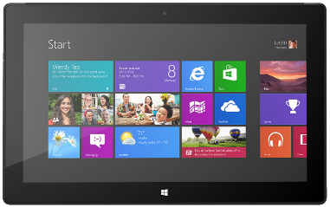
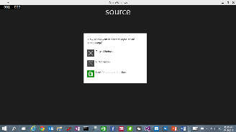
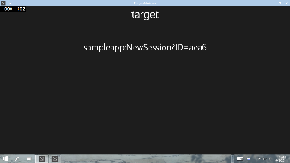
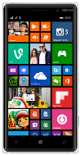


App to App in Windows 8.1
URI/Protocol Activation
Launcher.LaunchUriAsync(new Uri("sampleapp:?ID=aea6"));
Launcher.LaunchFileAsync(file);
Data in Uri/File
User/OS chooses target
Notes:
Today we have LaunchUriAsync and LaunchFileAsync. These let the user or the operating system choose the target. There’s fear of your protocol scheme being hijacked.

Slide 5
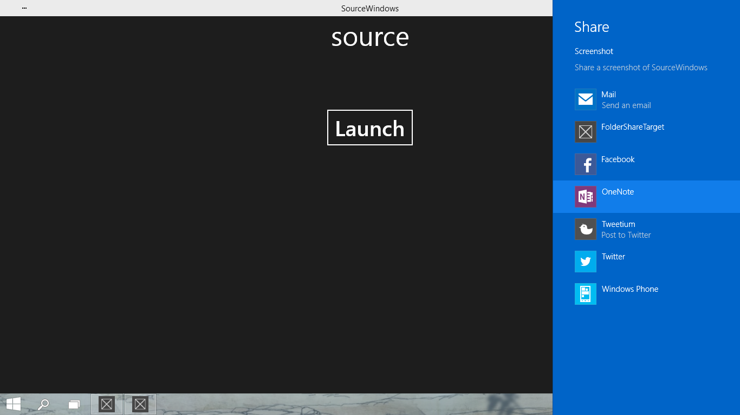
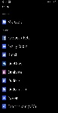
App to App in Windows 8.1
Share Contract
DataTransferManager.ShowShareUI();
Share DataPackage
User chooses target
Notes:
Share contract ALWAYS shows a picker. The user always chooses the target

Slide 6
App to App in Windows 10 UWP

Slide 7
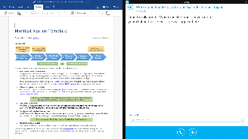
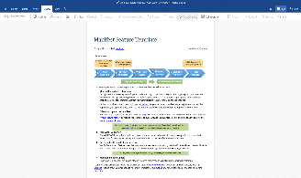

Enhanced App to App in Windows 10
Launch a *specific* app
Send file token, send data
Launch for Results
App Services
Notes:
You can now launch specific apps, send them data and send them files using Launcher.LaunchUriAsync.
You can also launch specific apps when using Launcher.LaunchFileAsync. Note that the API to set TargetApplicationPFN is there it only actually works for the LaunchForResults scenario at the moment and that too on the Mobile SKU.

Slide 8
URI Activation++
Invoke a specific app
var options = new LauncherOptions();
options.TargetApplicationPackageFamilyName = "24919.InstapaperIt";
var launchUri = new Uri("instapaper:?AddUrl=http%3A%2F%2Fbing.com");
await Launcher.LaunchUriAsync(launchUri, options);
Notes:
Here’s how invoking a specific app works. The key is the new TargetApplicationPackageFamilyName property. In a moment we’ll see where this value comes from.

Slide 9
URI Activation++
Send Files
var options = new LauncherOptions();
options.TargetApplicationPackageFamilyName = "24919.InstapaperIt";
var token = SharedStorageAccessManager.AddFile (gpxFile);
ValueSet inputData = new ValueSet();
inputData.Add("Token", token);
var launchUri = new Uri("instapaper:?AddUrl=http%3A%2F%2Fbing.com");
await Launcher.LaunchUriAsync(launchUri, options, inputData);
Notes:
Here’s how you share a file. We’re introducing a new set of APIs that you can use to turn the file into a string token. The receiving app can then redeem that token for a file on the other end.

Slide 10
Query URI Support
Discover if app already installed to handle a Uri
var queryUri = new Uri("instapaper:");
await Launcher.QueryUriSupportAsync(queryUri, LaunchUriType.LaunchUri);
var queryUri = new Uri("instapaper:");
string packageFamilyName = "24919.InstapaperIt";
await Launcher.QueryUriSupportAsync(queryUri, LaunchUriType.LaunchUriForResults, packageFamilyName);
?

Slide 11

App Services Covered in separate module
Client App A
App with App Service
Client App B
Background Task

Slide 12
URI Activation for Device Settings
Category | Settings page | Mobile and/or Desktop | Uri
System | Display (on desktop) Screen (on mobile) | Both | ms-settings://screenrotation
 | Notifications | Both | ms-settings://notifications
 | Storage Sense | Both | ms-settings://storagesense
 | Battery Saver | Both | ms-settings://batterysaver
 | Maps | Both | ms-settings://maps
Devices | Bluetooth | Both | ms-settings://bluetooth
Network and Wi-fi | Wi-Fi | Both | ms-settings://network/wifi
 | Airplane mode | Both | ms-settings://network/airplanemode
 | Cellular | Both | ms-settings://network/cellular
 | Data Sense | Both | ms-settings://datasense
 | NFC | Mobile only | ms-settings://proximity
 | Proxy | Desktop only | ms-settings://network/proxy
More… [See documentation for complete list]

Slide 13
URI Activation in UWP

Slide 14
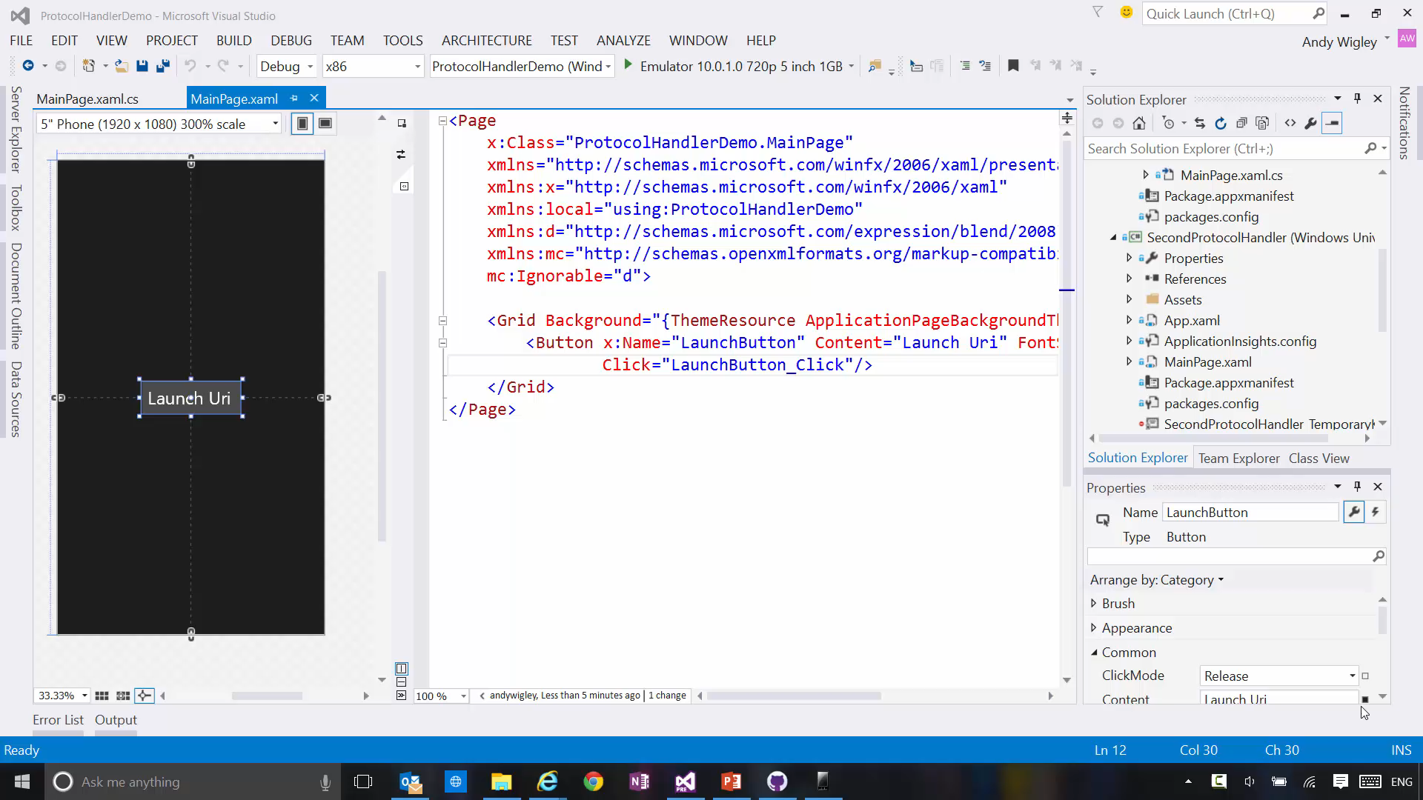

Slide 15
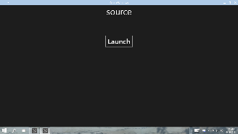

Launch for Results
Launching the app
var options = new LauncherOptions();
options.TargetApplicationPackageFamilyName = "24919.Instap";
var launchUri = new Uri("instapaper:?AddUrl=http%3A%2F%2Fbing.com");
await Launcher.LaunchUriForResultsAsync(launchUri, options, data);
var resultData = new ValueSet();
resultData.Add("Result", value);
operation.ProtocolForResultsOperation.ReportCompleted(resultData);A
App1
App2
Notes:
Here’s how you launch an app for results. The TargetApplicationPackageFamilyName is mandatory for this scenario.

Slide 16
Launch for Results

Slide 17
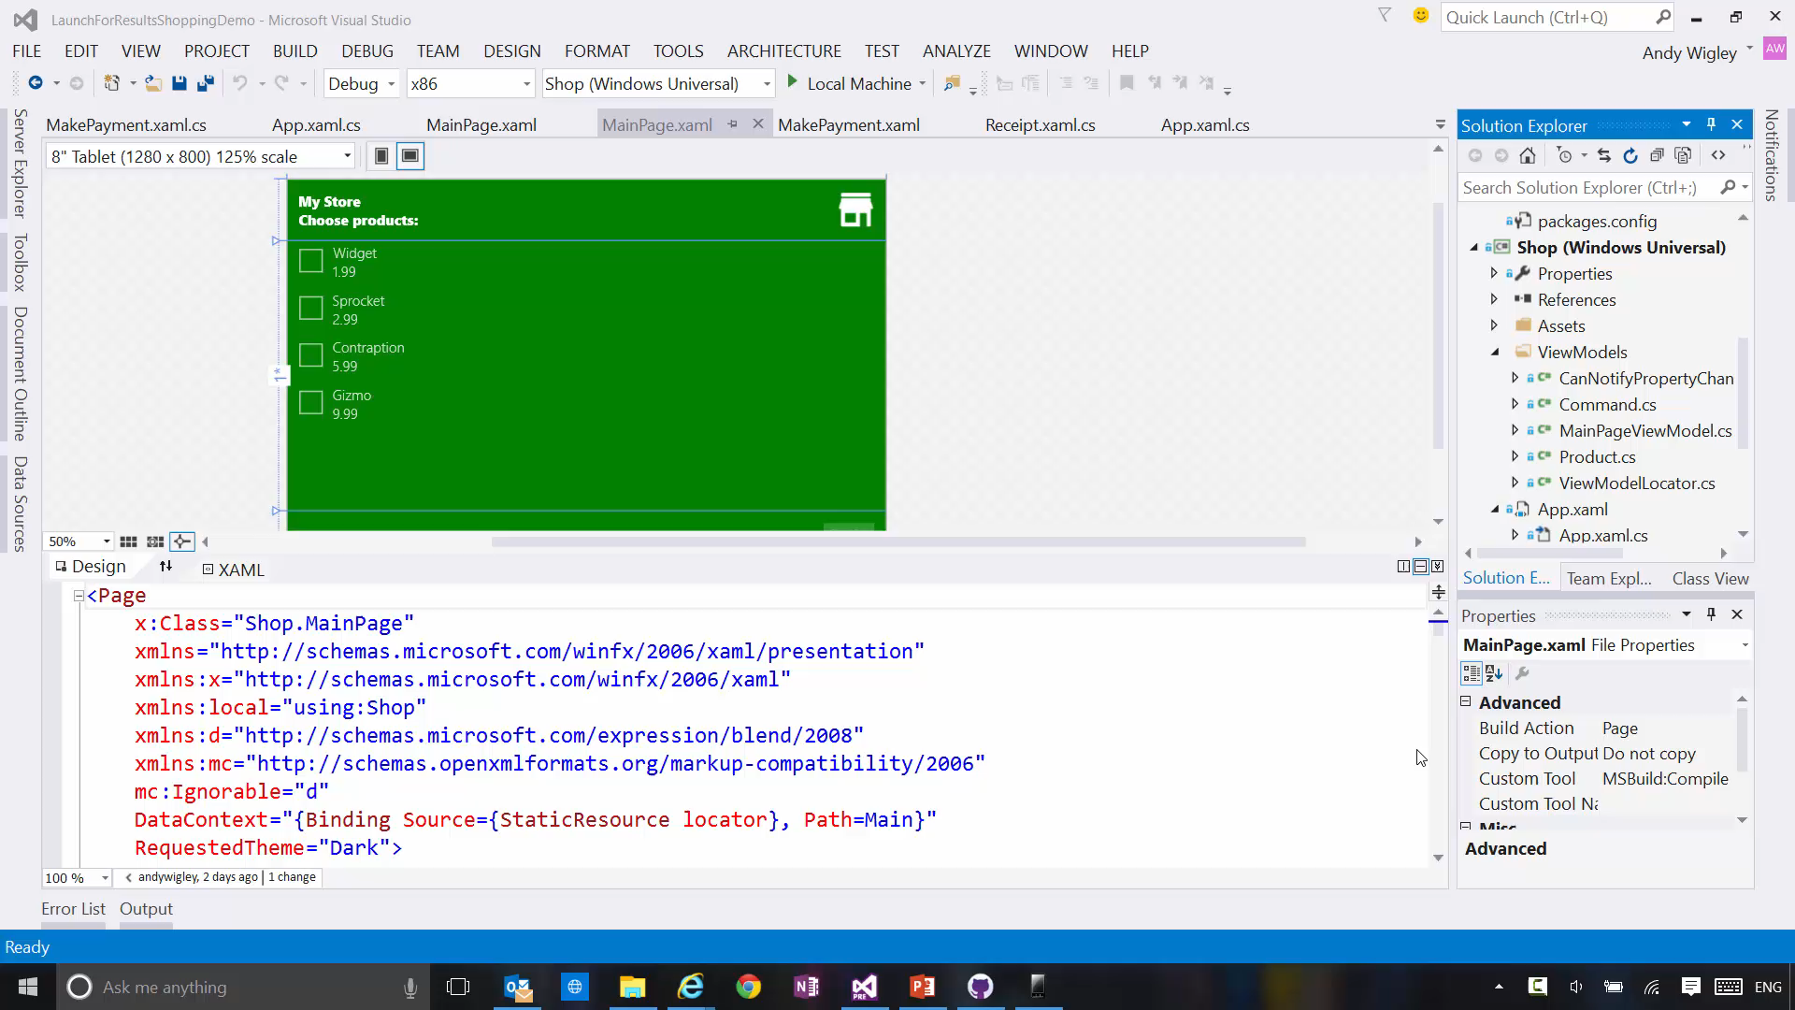

Slide 18
Apps from the same publisher share files and settings

Slide 19
Publisher’s shared storage folder
A subfolder is required. Edit app manifest to add. Folders are automatically provisioned.
<Package> <Extensions>
<Extension Category="windows.publisherCacheFolder"> <PublisherCacheFolder> <Folder Name="Folder1"> </PublisherCacheFolder> </Extension>
</Extensions> </Package>

Slide 20
Shared storage folder interaction
Access folder named “fonts”
Windows.Storage.ApplicationData.Current .GetPublisherCacheFolder("fonts");
Clear shared storage
Windows.Storage.ApplicationData.Current .ClearPublisherCacheFolderAsync();

Slide 21
Review
App to App in Windows 8.1
URI and Protocol Activation
Share Contract
App to App in Windows 10 UWP
URI Activation to a Specific App
Send Files
Query Uri Support
App Services
Shared Storage
Publishers’ Shared Storage Folder

